Slide 1
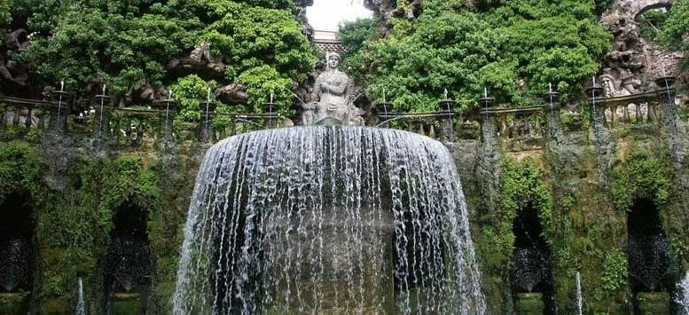
S M A R T
TEAM MEMBERS:
P. BALAGURU
U. MANGALESHWAR
S. SELVAKUKAR
J. MOHAN
A. ARUNDASS
W
A
T
E
R
F
O
U
N
T
A
I
N

Slide 2
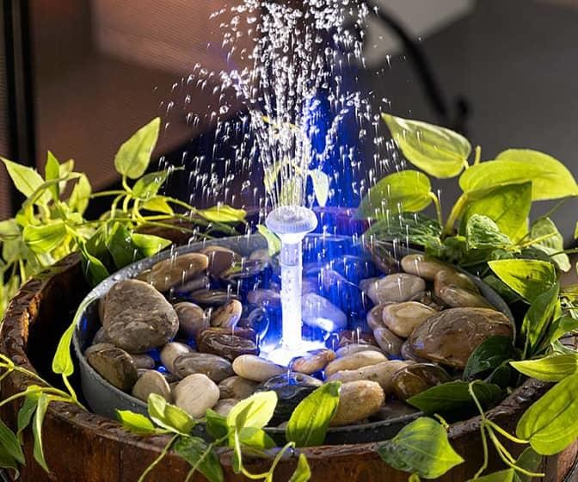
OBJECTIVE :
IT’S GREAT FOR BEGINNER PROJECTS AND SUPER EASY TO USE! THE PUMP IS BASICALLY A DC MOTOR THAT IS POWERED WITH 3V AND DRAWS 100MA. WHEN POWERED, THE PUMP SUCKS WATER IN FROM THE SIDE OF THE PLASTIC CASING AND PUSHES IT OUT THE TUBING PORT. THE PUMP MUST BE PRIMED BY KEEPING IT INSIDE WATER AT ALL TIMES.

Slide 3
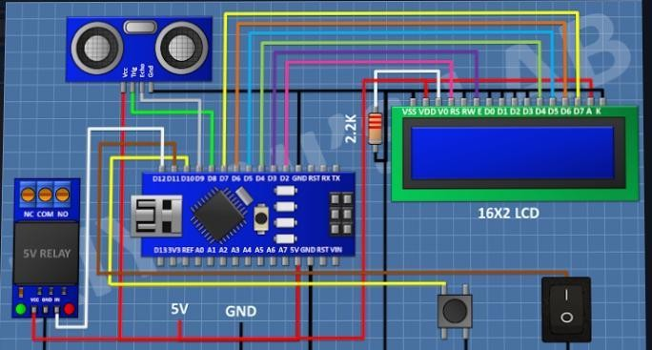
COMPONENTS:
ARDUINO UNO OR ARDUINO NAN
1K 0.25WATT RESISTORS – 8 NO (R1 – R8)
10K 0.25WATT RESISTORS – 4 NO (R9 – R12)
BC547 NPN TRANSISTOR (Q1)
LED 5MM – 7NO
2-PIN TERMINAL CONNECTORS (5 NO)

Slide 4
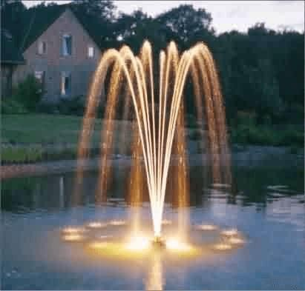
DESIGN FEATURES :
FOUNTAINS WIRELESSLY COMMUNICATE WITH BASE STATIONS
BASE STATIONS COLLECT AND TRANSMIT USAGE, FILTER, AND
SYSTEM HEALTH INFORMATION TO THE CLOUD VIA ETHERNET
WIRELESS COMMUNICATIONS USE A LOW-POWER UNLICENSED BAND FOR IMPROVED SECURITY AND POWER SAVINGS

Slide 5
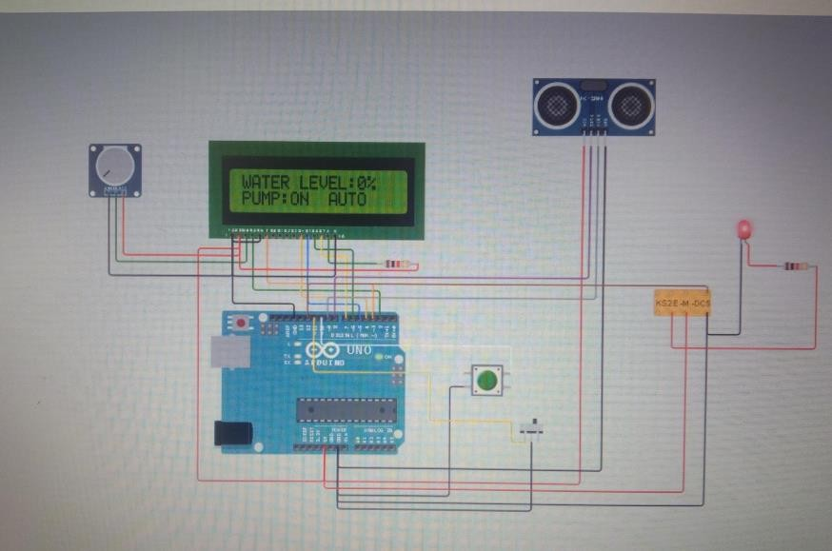
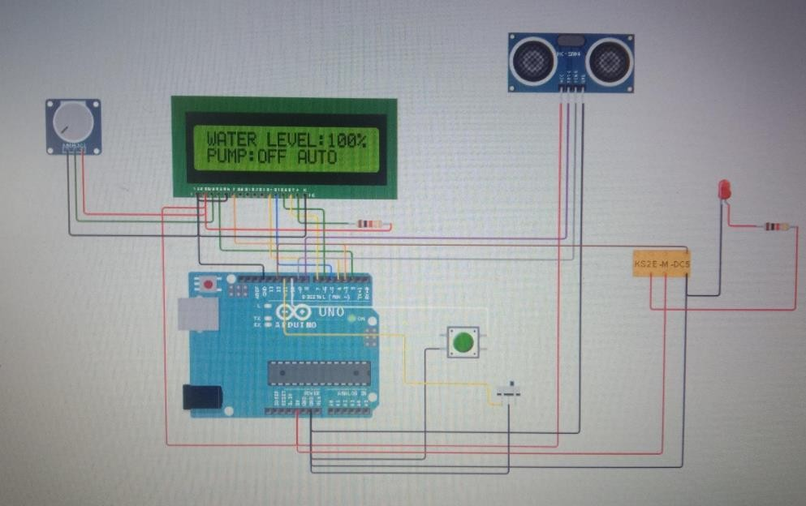
CIRCUIT :
AUTO:
ON
OFF

Slide 6
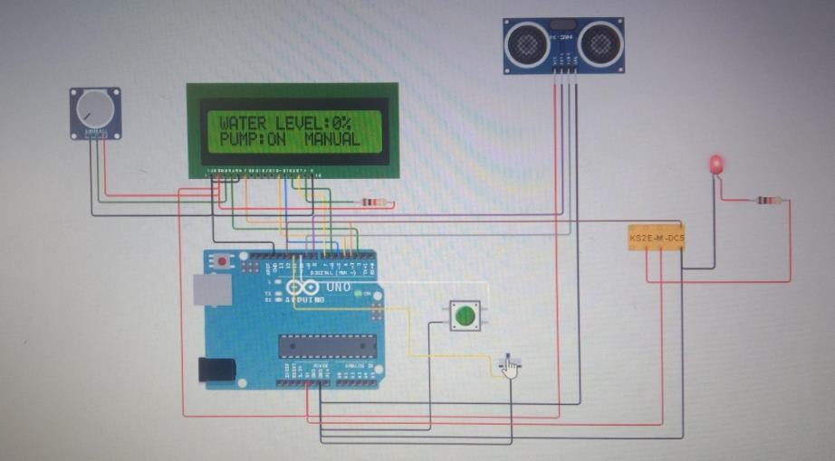
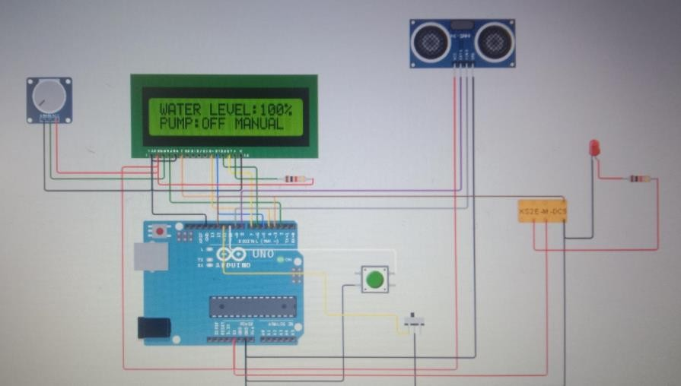
MANUAL:
ON
OFF

Slide 7
WORKING:
IN MANUAL;
IF TANK IS EMPTY, WE NEED TO TURN ON MANUALLY
. IN AUTO;
IF TANK IS EMPTY, MOTOR TURN ON AUTOMATICALLY

Slide 8
#include <EEPROM.h> #include <LiquidCrystal.h> LiquidCrystal lcd(2,3,4,5,6,7); long duration, inches;
int set_val,percentage; bool state,pump;
void setup() {
lcd.begin(16, 2); lcd.print("WATER LEVEL:"); lcd.setCursor(0, 1); lcd.print("PUMP:OFF MANUAL");
pinMode(8, OUTPUT);
pinMode(9, INPUT); pinMode(10, INPUT_PULLUP); pinMode(11, INPUT_PULLUP);
pinMode(12, OUTPUT);

Slide 9
set_val=EEPROM.read(0); if(set_val>150)set_val=150;} void loop() {
digitalWrite(3, LOW);
delayMicroseconds(2); digitalWrite(8, HIGH); delayMicroseconds(10); digitalWrite(8, LOW); duration = pulseIn(9, HIGH);
inches = microsecondsToInches(duration); percentage=(set_val-inches)*100/set_val; lcd.setCursor(12, 0); if(percentage<0)percentage=0; lcd.print(percentage);
lcd.print("% "); if(percentage<30&digitalRead(11))pump=1; if(percentage>99)pump=0; digitalWrite(12,!pump);

Slide 10
lcd.setCursor(5, 1); if(pump==1)lcd.print("ON ");
else if(pump==0) lcd.print("OFF");
lcd.setCursor(9, 1); if(!digitalRead(11))lcd.print("MANUAL"); else lcd.print("AUTO "); if(!digitalRead(10)&!state&digitalRead(11)){ state=1;
set_val=inches; EEPROM.write(0, set_val);
}
if(!digitalRead(10)&!state&!digitalRead(11)){ state=1;
pump=!pump;
}
if(digitalRead(10))state=0; delay(500);
}
long microsecondsToInches(long microseconds) { return microseconds / 74 / 2;
}

Slide 11
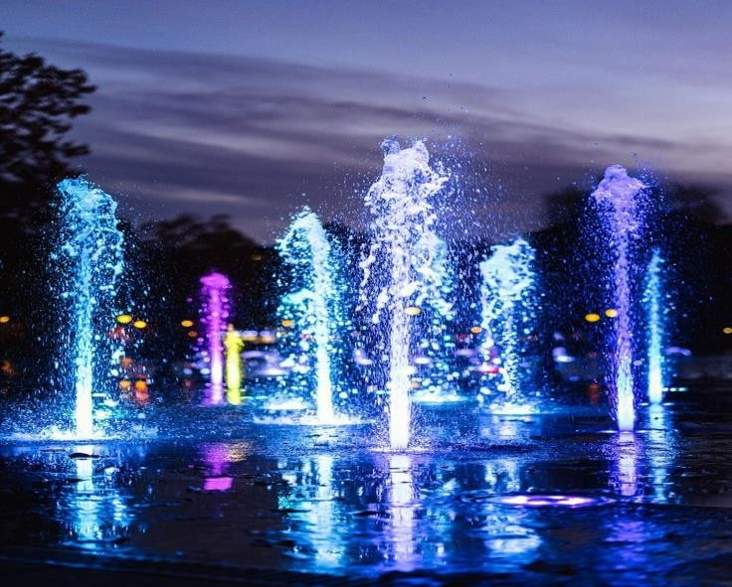
OUTPUT LINK:
HTTPS://WOKWI.COM/PROJECTS/379631344770984961

Slide 12


